Slide 1
GL50(R)-
HARMONISATION OF CRITERIA TO WAIVE TARGET ANIMAL BATCH SAFETY TESTING FOR INACTIVATED VACCINES FOR VETERINARY USE ( May 2017)
GL55-
HARMONISATION OF CRITERIA TO WAIVE TARGET ANIMAL BATCH SAFETY TESTING FOR LIVE VACCINES FOR VETERINARY USE ( May 2017)
JMAFF, JVPA

Slide 2
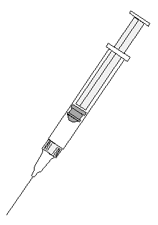

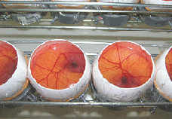
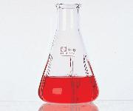

What is batch safety test (BST) ?
＜e.g.＞ Production protocol of ND live vaccine
Inoculate production seed virus in 11-day-old
embryonated eggs
Incubate for 7 days at 37 ˚C
2 Gather chorioallantoic fluid from eggs, filter, and
centrifuge
3 Add diluent and stabilizer
4 Place aliquots in vials and freeze-dry

Slide 3
What is batch safety test (BST) ?
Test for Degree of vacuum
Humidity Test
Final products
Sterility Test
Mycoplasma Test
Extraneous virus Test
Virus content Test
Potency Test
Batch Safety Test
Laboratory animal safety Test
Target animal safety Test

Slide 4
What is batch safety test (BST) ?
Tests in target and/or laboratory animals
  ・For Final product of broad group of vaccines
Considered as general safety tests
  ・Vaccines may change its safety/toxicity batch to batch
  ・Need assurance that a batch will be safe
BST should uncover;
  ・Abnormal local or systemic reactions (EU)*
  ・Unfavorable reactions (US)
  ・Abnormal changes (Japan)
  (*The TABST is deleted from Ph.Eur. monographs since 2013 and so is
  no longer applicable in the EU.)

Slide 5
VICH 3Rs Statement
At its 19th meeting in 2007 in USA, the SC reiterated its ambition to minimise animal testing
Support for the 3Rs principle
  replacement, refinement and reduction
[Statement of Principle for VICH - Alternatives to Animal Testing (VICH/07/038-Final; 18/09/2007)]

Slide 6
Are BSTs for vaccines necessary?
Decreased concern on adverse reactions of vaccines
Due to the Improvements in
-Quality of raw materials
-Culture / Purification method
-Assay method
-Seed lot system / GMP standard
-Safety testing under GLP standard

Slide 7

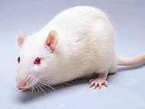
Categorization of BST Waiver GLs:
Animal Species | Inactivated Vaccine | Live Vaccine
Target Animals | GL50R | GL55
Laboratory Animals | Out scope of GL50R and GL55

Slide 8
What is TABST GL?
Formal name:
  Harmonisation of criteria to waive target animal batch safety testing for inactivated vaccines for veterinary use（GL50R）
  Harmonisation of criteria to waive target animal batch safety testing for live vaccines for veterinary use（GL55）
Very exceptional in whole VICH GLs
  Usual GLs are test requirement for registration
  TABST GL is applied to vaccine already registered in the past
It shows how to discontinue TABST
  An administrative guidance
  The SC accepted this exception for the 3Rs principle

Slide 9
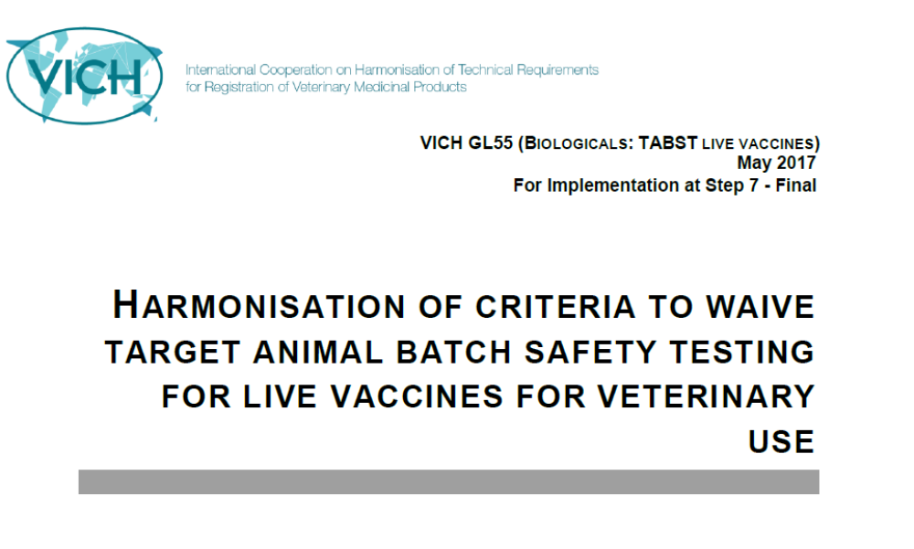
VICH-GL55

Slide 10
TABLE OF CONTENTS
1. INTRODUCTION
1.1. Objective of the Guideline
1.1.1. Background
2. GUIDELINE
2.1. Scope
2.2. Regional Requirements
2.2.1. General batch safety testing
2.2.2. Other relevant requirements
2.2.2.1. Quality systems
2.2.2.2. Seed lot system
2.2.2.3. Pharmacovigilance
2.3. Data Requirements for Waiving of Target Animal Batch Safety Tests
2.3.1. Introduction
2.3.1.1. The characteristics of the product and its manufacture
2.3.1.2. Information available on the current batch safety test
2.3.1.3. Pharmacovigilance data
2.3.2. Procedure for waiving the target animal batch safety test
3. GLOSSARY
4. REFERENCES

Slide 11
VICH-GL55
2. GUIDELINE
2.1. Scope
    This guideline is limited to the criteria on data requirements for waiving target animal batch safety tests (TABST) of live veterinary vaccines.
2.2. Regional Requirements
  2.2.1. Target animal batch safety testing
    Current procedure for TABST in VICH region.
  2.2.2. Other relevant requirements
    Good Manufacturing Practice (GMP)
    Seed lot system
    Pharmacovigilance

Slide 12
VICH-GL55
2.3. Data requirements for waiving of target animal batch safety tests
  2.3.1. Introduction
  The TABST may be waived by the regulatory authority when;
  a sufficient number of consecutive production batches have been produced and
  comply with the tests (on specification), thus
  demonstrate consistency of the manufacturing process.

Slide 13
VICH-GL55
2.3.1.1. The characteristics of the product and its manufacture
The manufacturer should demonstrate that the product is manufactured following the quality principles (e.g. seed lot system and GMP)
When other batch tests in target animals (e.g. potency tests) are conducted during the manufacturing process, it is recommended to gain additional safety data of the vaccine.

Slide 14


Concept of Seed-lot system
Master Seed [PassX]
Definitive specification
Full testing data
  Extraneous virus
  Target animal safety
  Pathogenicity reversion
  Sterility, Mycoplasma …etc.
passages
Working Seed
[PassX+3]
passage
Minimum specification with limited testing, e.g., Sterility, Mycoplasma…
Production Seed
[PassX+4]
Limited passage number from
Master Seed to Final Product,
e.g., Pass X+5
Bulk
Final Product
[Pass X+5]

Slide 15
VICH-GL55
Test for Degree of vacuum
Humidity Test
Sterility Test
Mycoplasma Test
Extraneous virus Test
Virus content Test
Potency Test
should submit batch protocol data
Laboratory animal safety Test
Target animal safety Test

Slide 16
VICH-GL55
2.3.1.2. Information available on the current batch safety test
  The manufacturer should submit batch protocol data for a sufficient number of consecutive batches (Usually 10 batches or a minimum of 5 batches if 10 batches are not manufactured within 3 years )
#1
#2
#3
#4
#5
#6
#7
#8
#9
#10
TABST
TABST
TABST
TABST
TABST
TABST
TABST
TABST
TABST
TABST
Passed
Passed
Passed
Passed
Passed
Passed
Passed
Passed
Passed
Passed

Slide 17
VICH-GL55
2.3.1.2. Information available on the current batch safety test
  The manufacturer should submit batch protocol data for a sufficient number of consecutive batches (Usually 10 batches or a minimum of 5 batches if 10 batches are not manufactured within 3 years )
  to demonstrate that safe and consistent production has been established.
    The conduct of the TABST shall be in accordance with the regional requirements.
    Variety of local and systemic reactions should be examined,
    Summary and discussion should be provided.

Slide 18
VICH-GL55
2.3.1.2. Information available on the current batch safety test
Generally, data from TABST of combined vaccines may be used to waive the TABST of vaccines containing fewer antigen and/or adjuvant components provided the remaining components are identical in each case and it is only the number of antigens and/or adjuvant which has decreased.

Slide 19
VICH-GL55
2.3.1.2. Information available on the current batch safety test
For example, TABST data from a combination product can be sufficient to waive TABSTs for all the fallout products. The manufacturer should provide a summary and discussion of the findings.
Vac.
ABC
Vac.
A
(ex.)
Data from TABST of combined Vaccine ABC may be used as data of Vaccine A
TABST
Passed
Data
Passed
Data

Slide 20




VICH-GL55
2.3.1.3. Pharmacovigilance data
A pharmacovigilance system (in accordance with the VICH Guidelines) is in place during the consecutive batches were on the market.
The Data to demonstrating the consistent safe performance of the vaccine in the field should be provided.
Report
Report
Report
Drug Distribution
Farm

Slide 21
VICH-GL55
2.3.2. Procedure for waiving the target animal batch safety test
  A report should provide an overall assessment of the consistency of the product’s safety and
  would include;
    the number of batches manufactured,
    the number of years the product has been on the market,
    the number of doses sold,
    the frequency and seriousness of any adverse reactions,
    investigations into the causes of these adverse reactions.

Slide 22
How is GL55 implemented in Japan ?
GL55 has been implemented in Japan from Apr. 2018.
1. Applicable vaccine
The vaccine which is fulfilled all of following requirements.
(1) Live vaccine for veterinary use.
(2) More than the last 10 batches were passed the TABST.
(3) Seed lot system-based product.

Slide 23
How is GL55 implemented in Japan ?
2. Application Documents
(1) Application for waiver of TABST
(2) Accompanying materials:
  A. Manufacturing records (last 10 batches)
  B. Batch release test data (last 10 batches)
  C. Information on a defect batch (if any)
  D. Revision history of the dossier
  E. Rational explanation for waiving TABST (on A to D above)
  F. Overall safety assessment including Pharmacovigilance data

